Slide 1
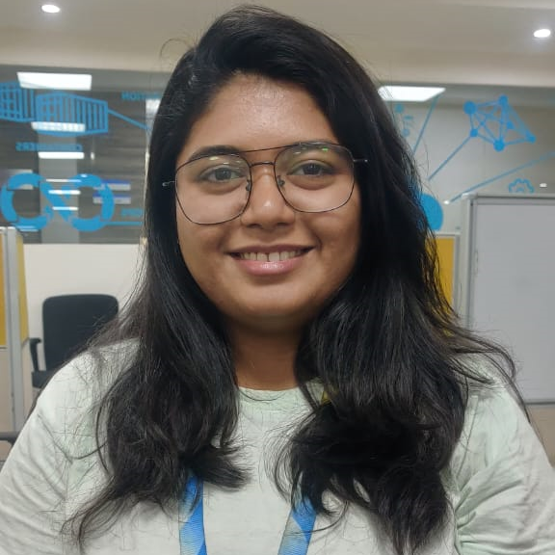

Vaishnavi Mate
Analyst/Software Engineer
Bachelor of Technology,
Computer Science Engineering : 2018-22
Mumbai
Vaishnavi.ganesh.mate@capgemini.com
Skills
8149584577
A4
C# | Basics, OOPS, Exception Handling ,Arrays ,Collection and Generics.
.NET Framework | ADO.NET, .NET 6 WEB API, Entity Framework , ASP .NET with MVC5.
Database | SQL , NOSQL
Tools | GIT,POSTMAN,JIRAVISUAL STUDIO,SSMS.
UI Technology | HTML5 ,CSS & Angular
Add On Skills | Communication Skills, Team Management
RollOff System for Employees.
Developed a WEB APPLICATION as part of case study using .NET WEBAPI , & ANGULAR.
Develop a project which helps to Roll off the employee. This project should act as a communication among Accounts team, PSP and admin. This web application automates and minimize the time off roll off process via email.
Version 1.0 include Searching employee and displaying details and requesting for rolloff.
Version 1.2 will include Accepting and rejecting rolloff , showing pending requests and sending mail to employees.
Tools Used:
Visual Studio 2022 & VS code
Understanding of RDBMS concepts using SQL Server.
Practical understanding of C# and SQL concepts using Visual Studio and SQL Server
Hands on experience in developing applications using ADO.NET,.NET Core
Proficient in creating Single page WebApplication in Angular .Hands on experience in developing web pages using HTML5, CSS3, Object Oriented, TypeScript .
Good Understanding of Oop concepts (Abstraction, Encapsulation, Polymorphism, Inheritance).
Github Link

